Slide 1
E-Commerce in US Portfolio
Analyzing and Maximizing Online Business Performance

Slide 2
About me
Hi, my name is Rofi Rosdiani. I am an aspiring Data Analyst. In this project, I want to perform Exploratory Data Analysis using Python Language and build visualization by Tableau. The project is about analyze performance E-Commerce in US to uncover insight and recommendation to company if it wants to compete with others, Let’s take a look!

Slide 3
Table of contents
01
02
Project Recap
Project Task
03
04
Process & Insight
Summary

Slide 4
01
Project recap
Flow Inc. is a new e-commerce that want to compete with others and have no idea about the performance of e-commerce in US

Slide 5
Project Task
02
As a data analyst, we are asked to provide data and analysis regarding the condition of e-commerce in the US to be presented to company stakeholders.
The things that will be reviewed are:
How is e-commerce sales growing at the moment?
How many companies get orders?
What products are most and least purchased by customers?
What payment methods do customers use more?
How many male and female customers by age category?

Slide 6


03
Process
1
Data Overview
2
Data Cleaning
3
Exploratory Data Analysis
4
Uncover Insights
& Recommendation

Slide 7
Data Overview
01

Slide 8
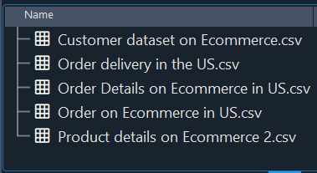

Data Overview
Python IDE
E-commerce in US dataset was provided by Kaggle. It contains information about customer, delivery, order, and product details.

Slide 9
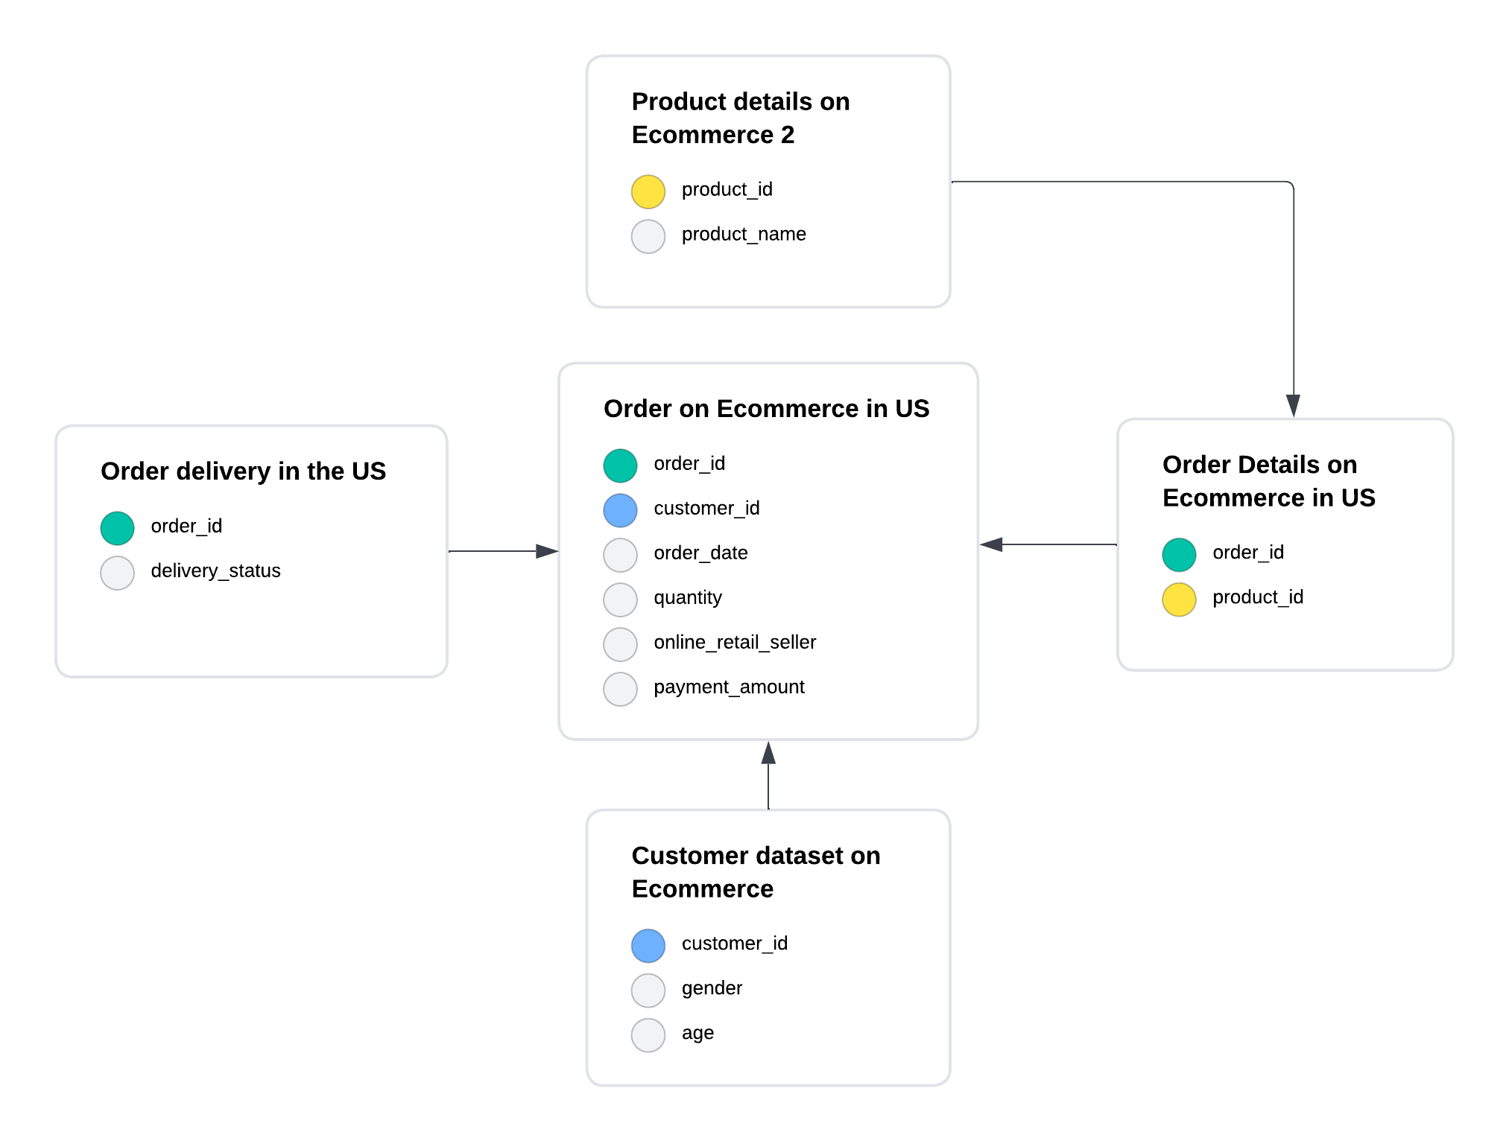
Entity Relationship Diagram
Important!!
It is strongly recommended to visualize our dataset by using entity relationship diagram before we dive into analysis. By doing so, we would able to determine correlation between tables in dataset.
In this analysis, we would only use these fives data for our analysis:
Order on Ecommerce in US
Order delivery in the US
Product details on Ecommerce 2
Order details on Ecommerce in US
Customer dataset on Ecommerce

Slide 10

Tools
Python IDE
Spyder is an open-source cross-platform integrated development environment for scientific programming in the Python language.
Tableau Software is an American interactive data visualization software company focused on business intelligence.

Slide 11
Data Cleaning
02

Slide 12
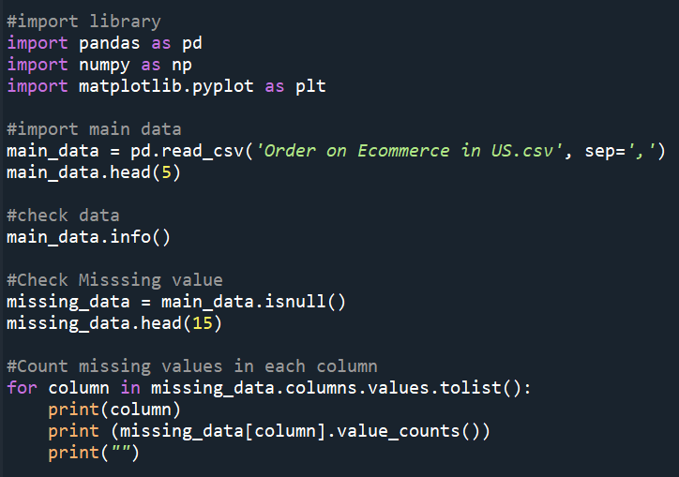
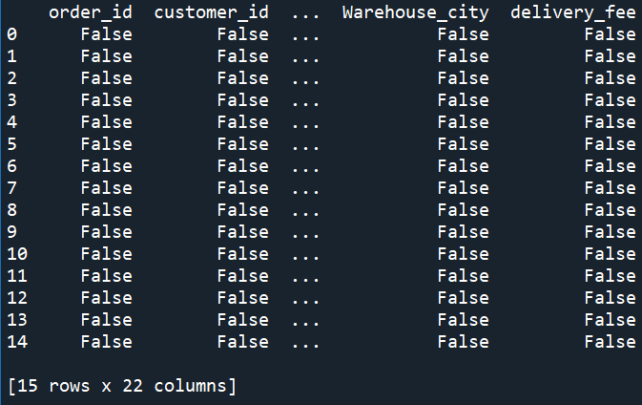
Check Missing Values
Query:
Output:

Slide 13
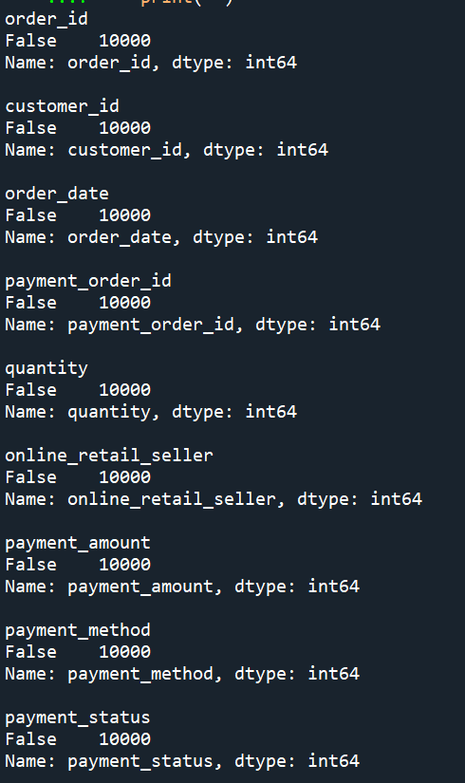
Check Missing Values
Output:
As the output based on this picture and before, we can said that there are no missing values. So we can continue our data cleaning.

Slide 14
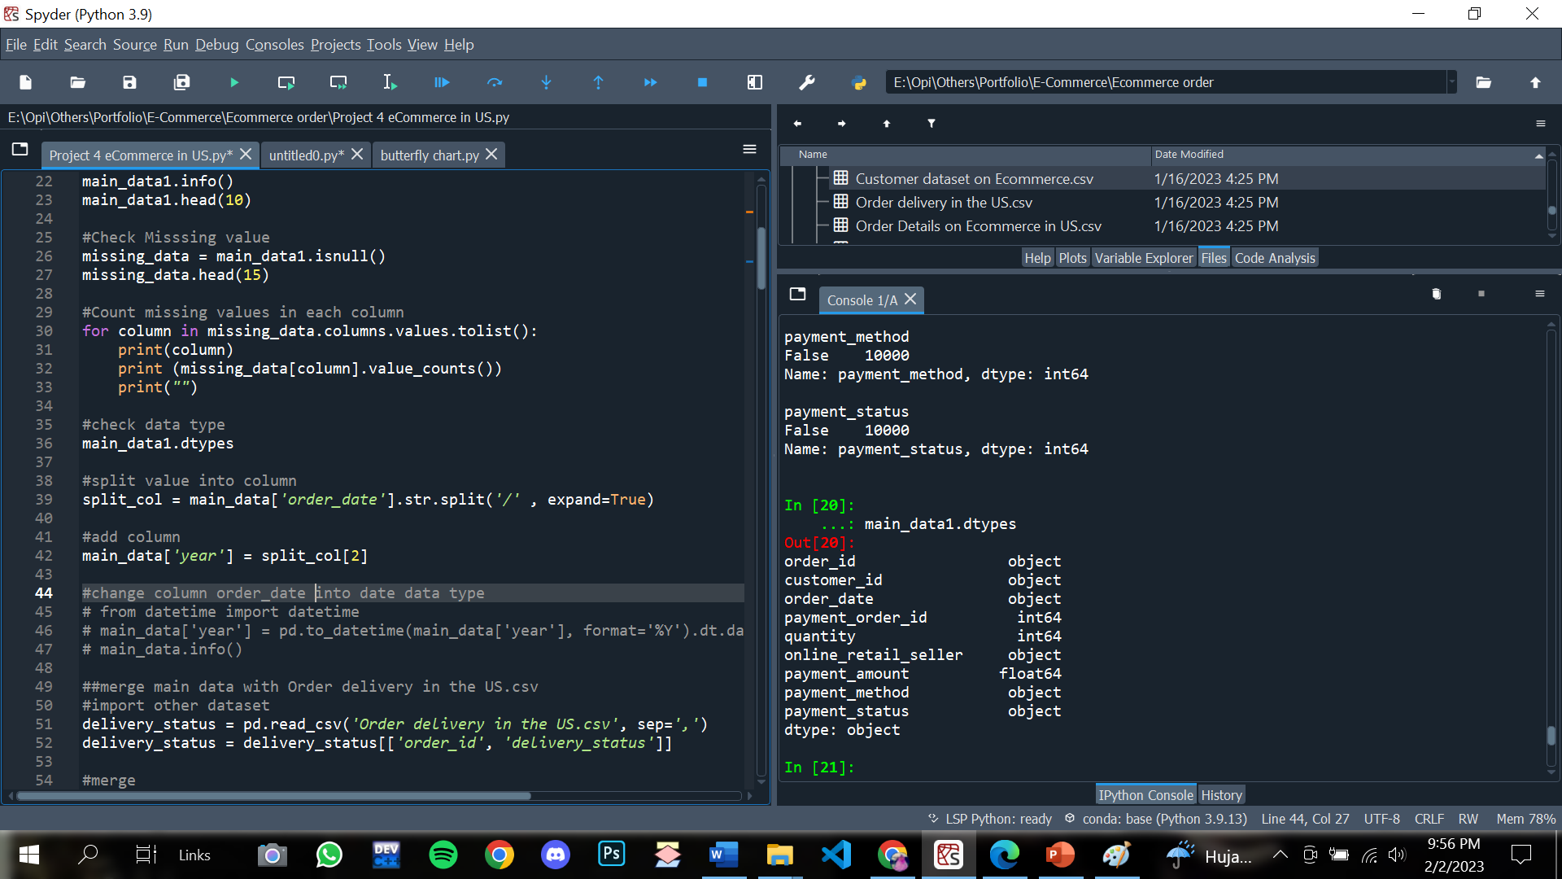
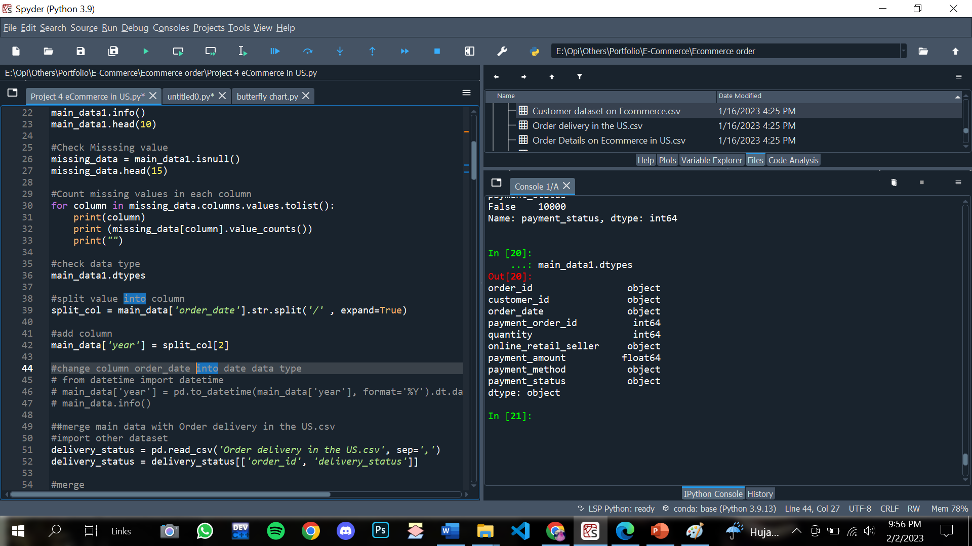
Correct data format
Query:
Output:
After we checked, for each column has the right datatype so we don’t need to change into others datatype.

Slide 15
Exploratory Data Analysis
03

Slide 16
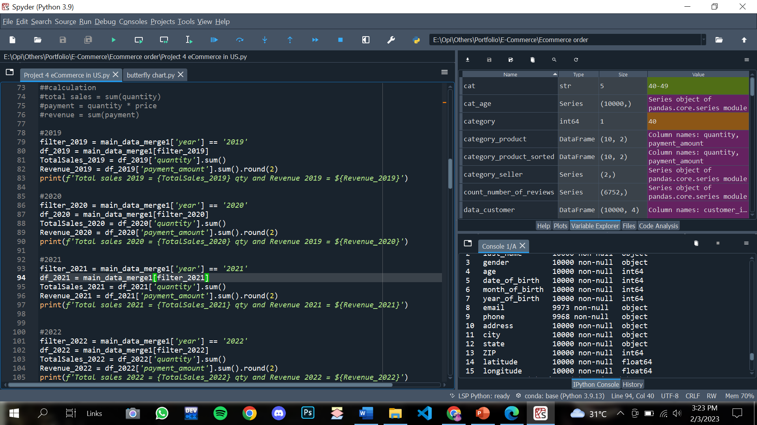
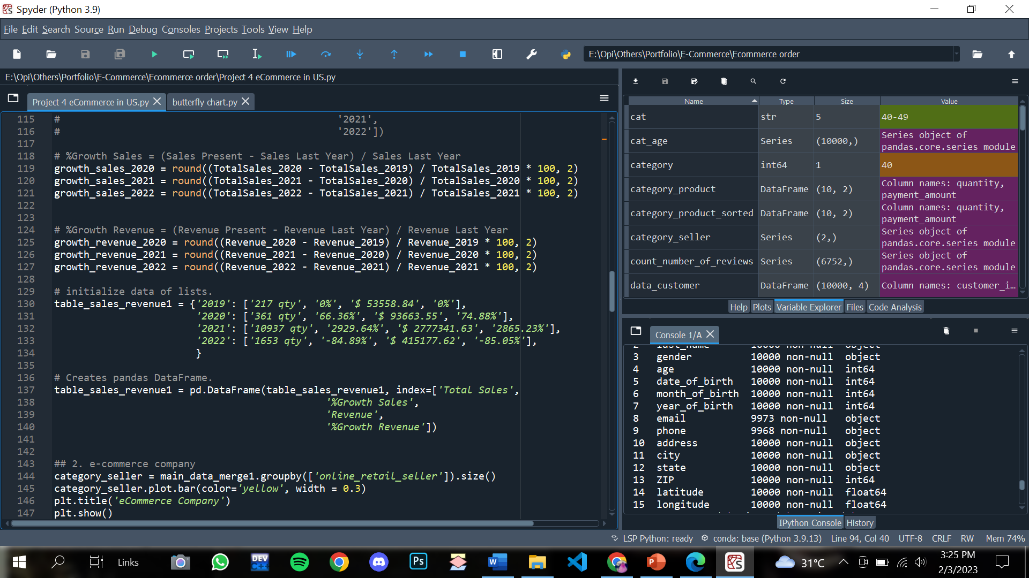
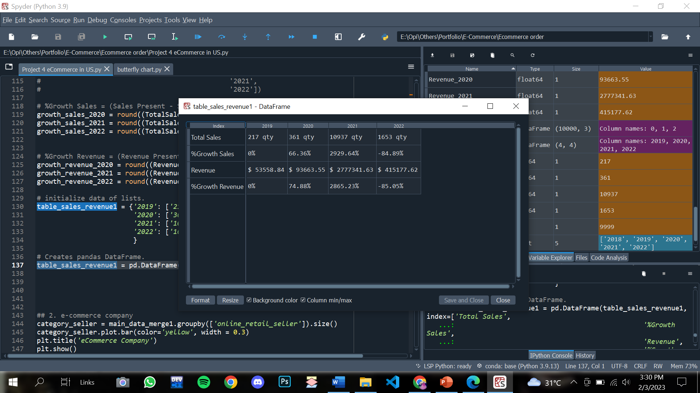
#1 Calculate total sales and revenue from 2019 – 2022 to find the sales growth
Query:
Output:

Slide 17
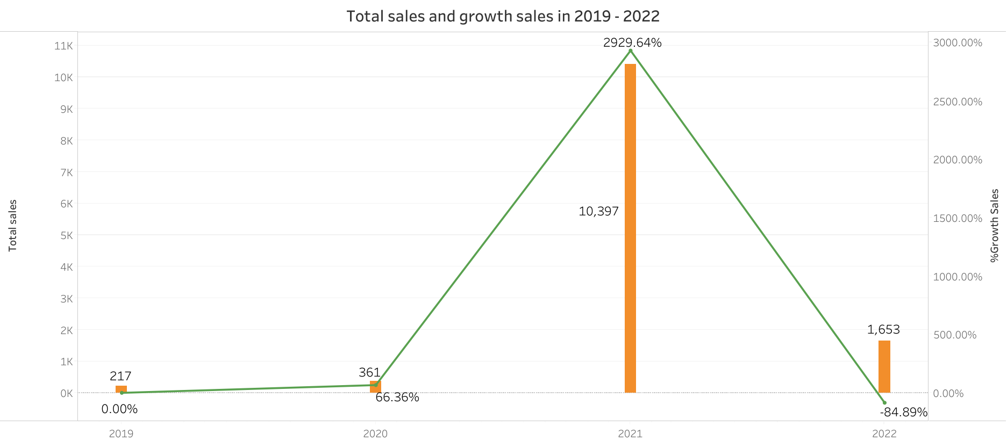
The maximum sales is 10.397 in 2021
Insight:
Based on the dual combination chart, the trend rate of e-commerce sales in the US tends to increase from 2019 - 2021, the highest percentage increase reaches 2930% with total sales of 10,397, then in the following year there is a decrease of 85%.

Slide 18
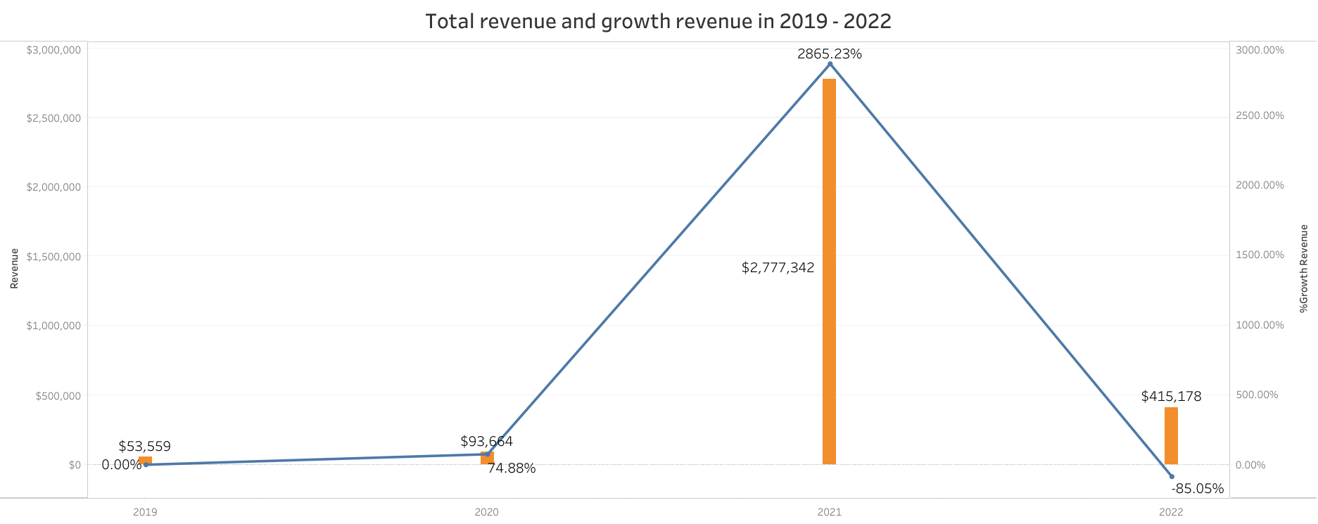
The maximum revenue is $ 2.777.342 in 2021
Insight:
Based on the dual combination chart, the trend rate of e-commerce revenue in the US tends to increase from 2019 - 2021, the highest percentage reaching 2865% with total revenue of $ 2,777,342, then in the following year there is a decrease of 85%. The trend of total revenue is in accordance with the trend of increasing sales in the first 3 years.

Slide 19
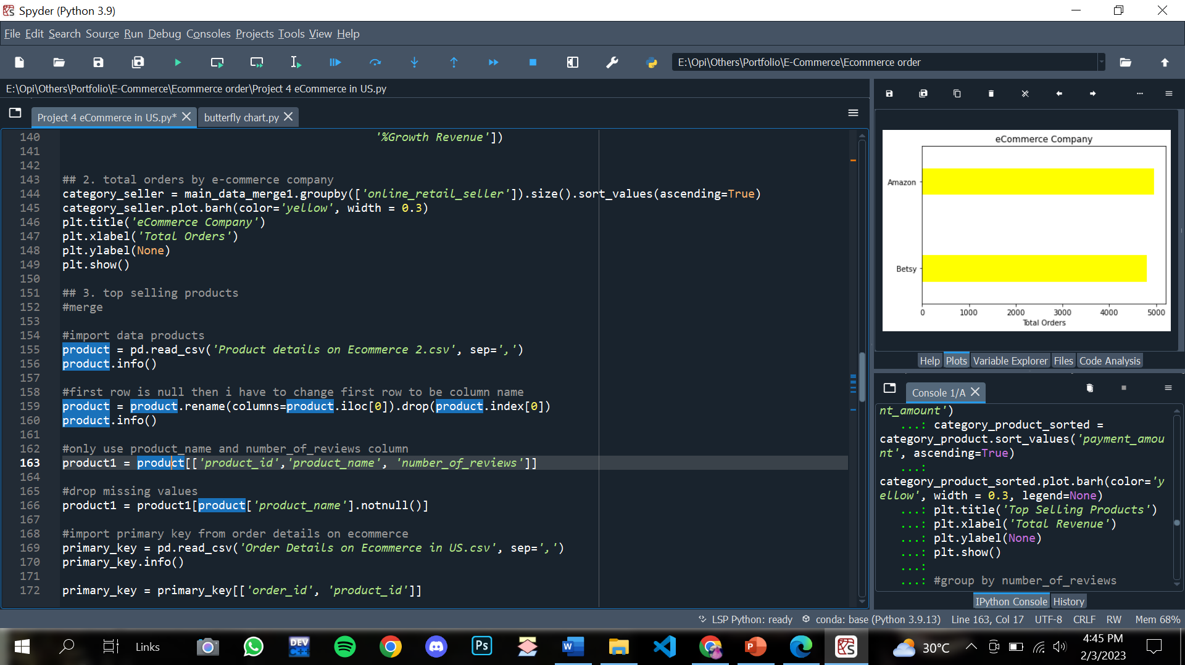
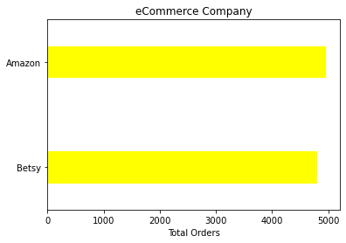
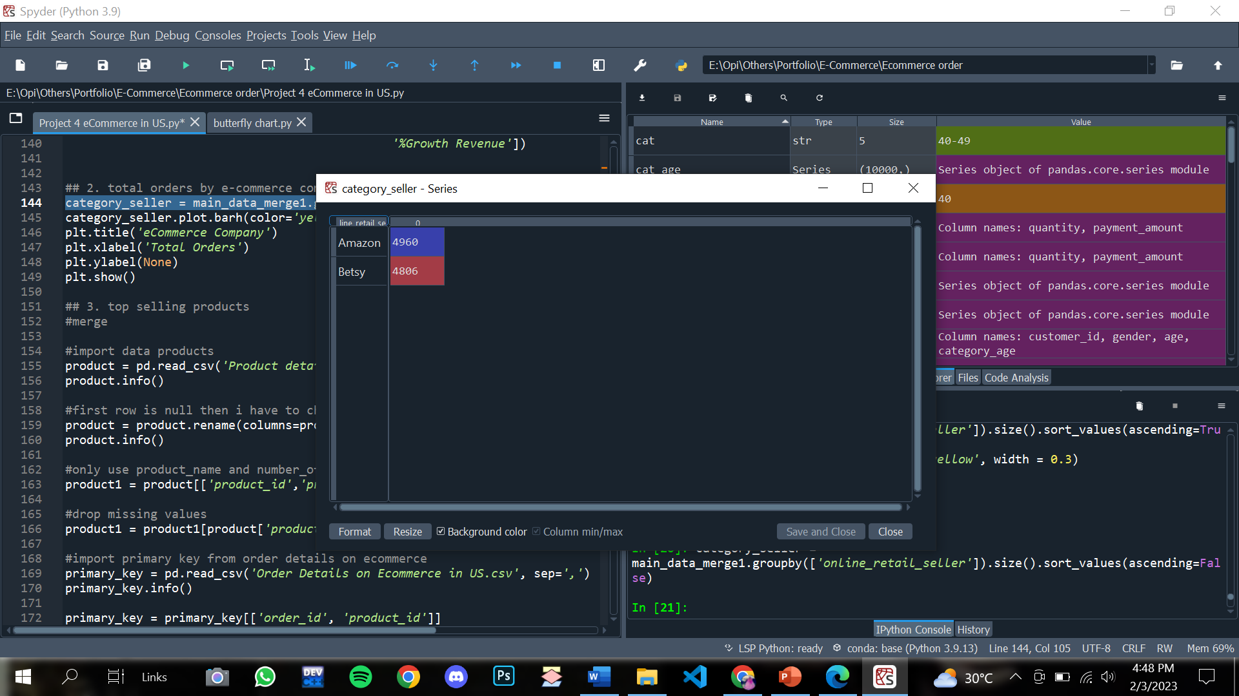
#2 Calculate number of orders by company name
Query:
Output:
Details Output:

Slide 20
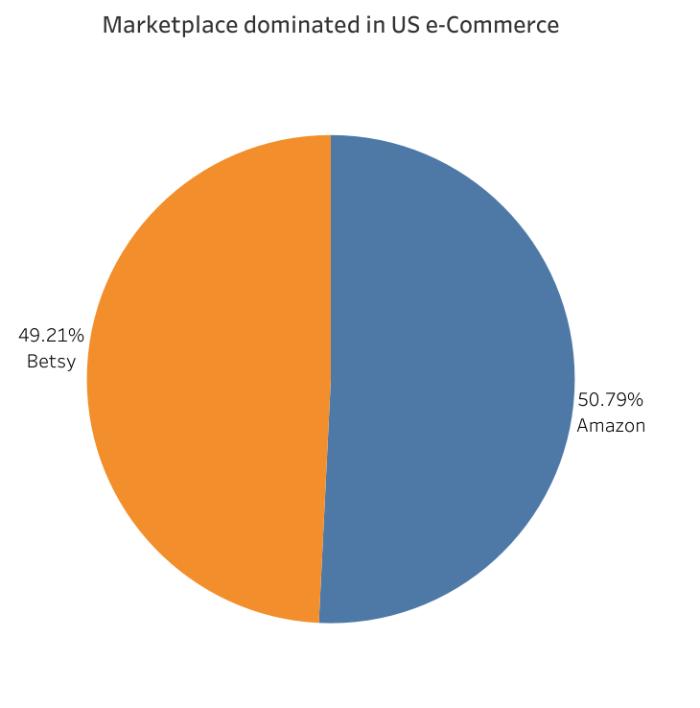
There are 2 marketplace dominated eCommerce in US
Insight:
Based on the pie chart, Amazon and Betsy are the marketplaces that dominate e-Commerce in the US. Amazon achieved total order of 51% while Betsy reached 49%. Both of them only have a slight difference of 1% from the overall total orders of 9.766 orders.

Slide 21
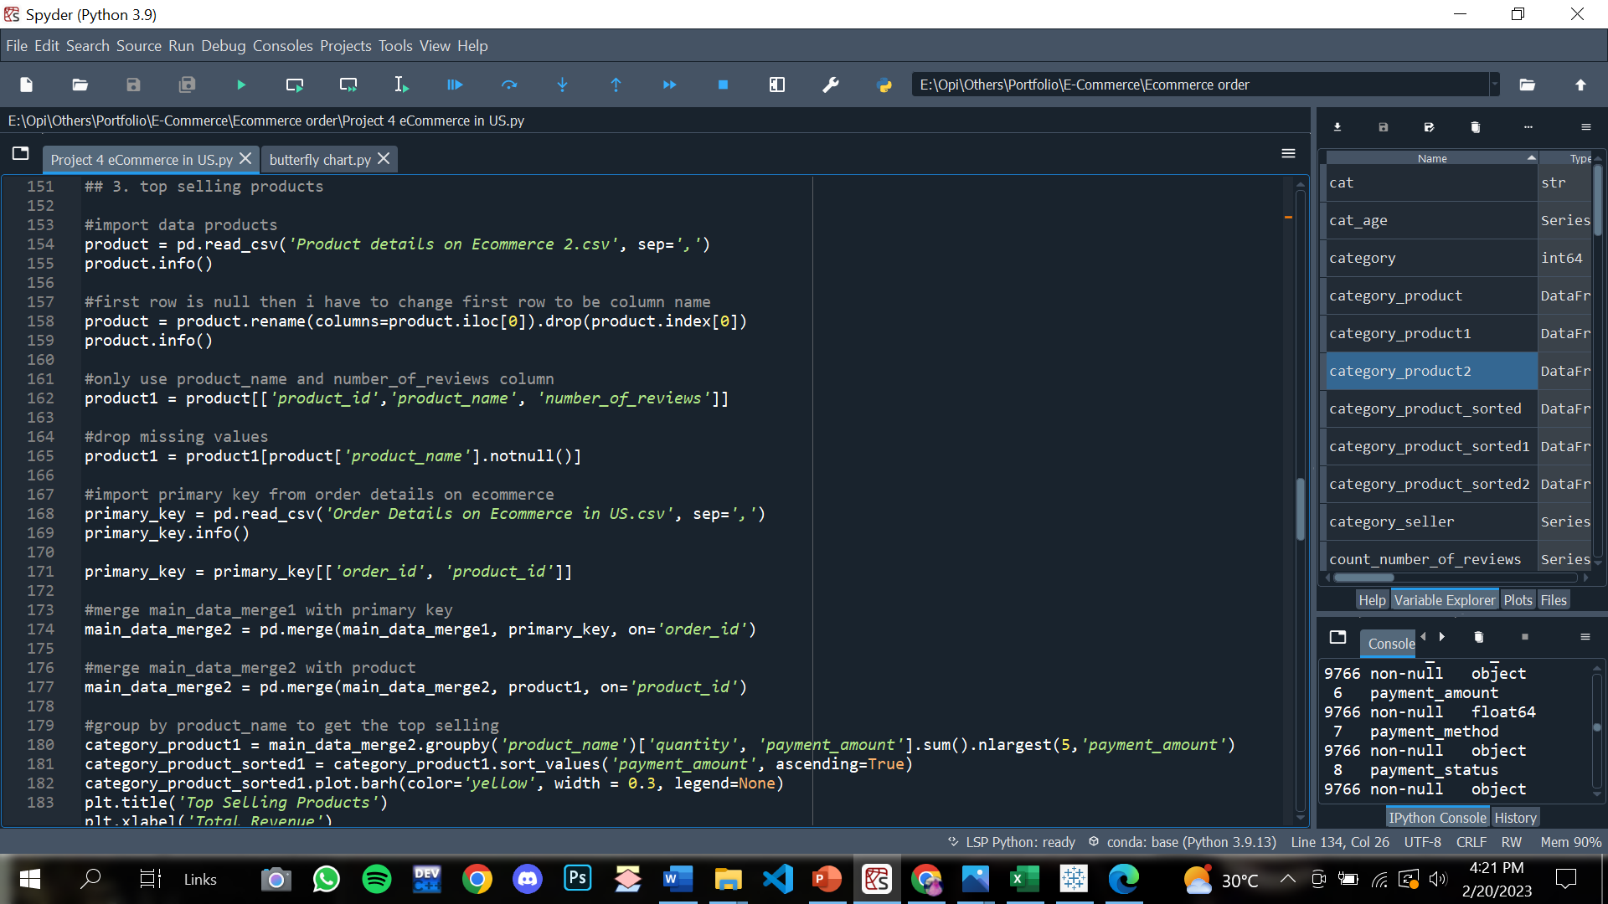
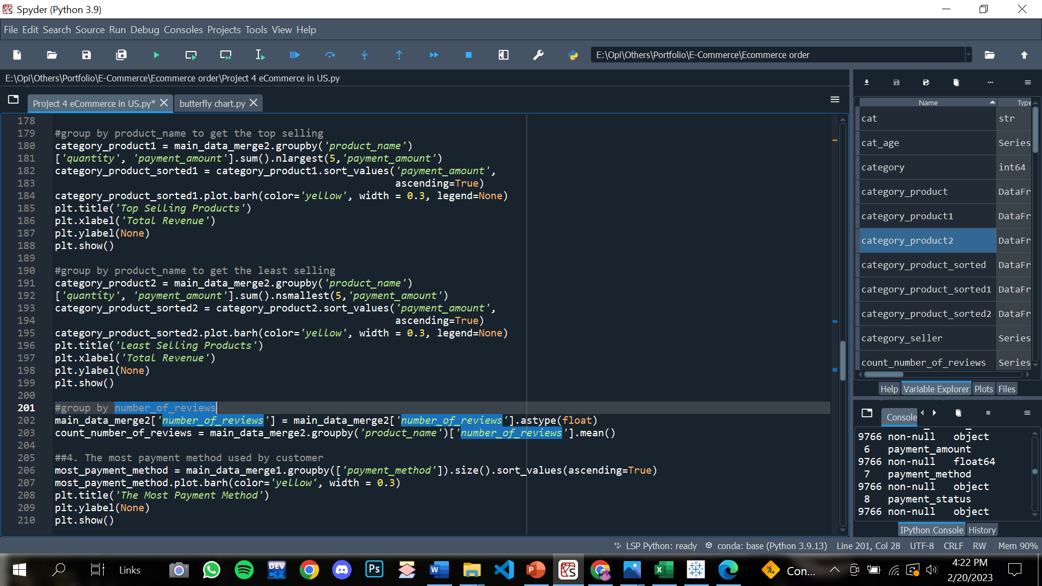
#3 Calculate number of quantity products to get most and the least products bought from customers
Query:

Slide 22
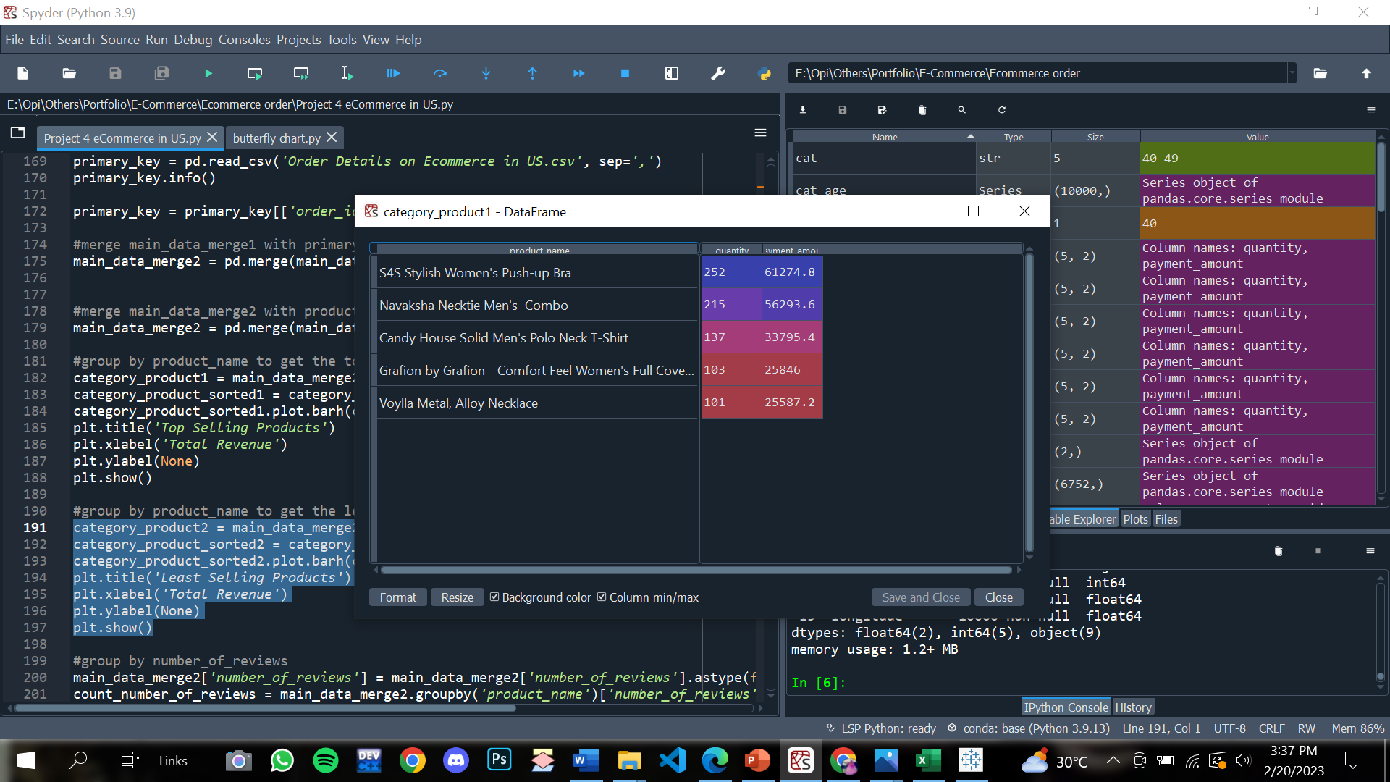
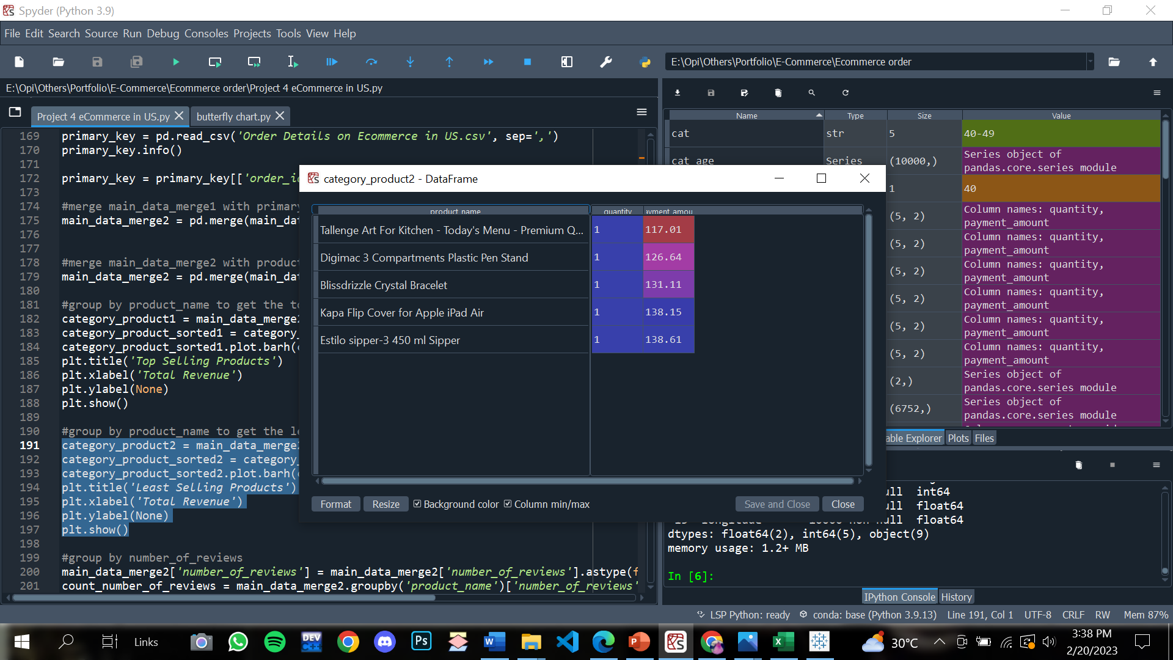
#3 Calculate number of quantity products to get most products bought from customers
Output:
Top selling products
Least selling products

Slide 23
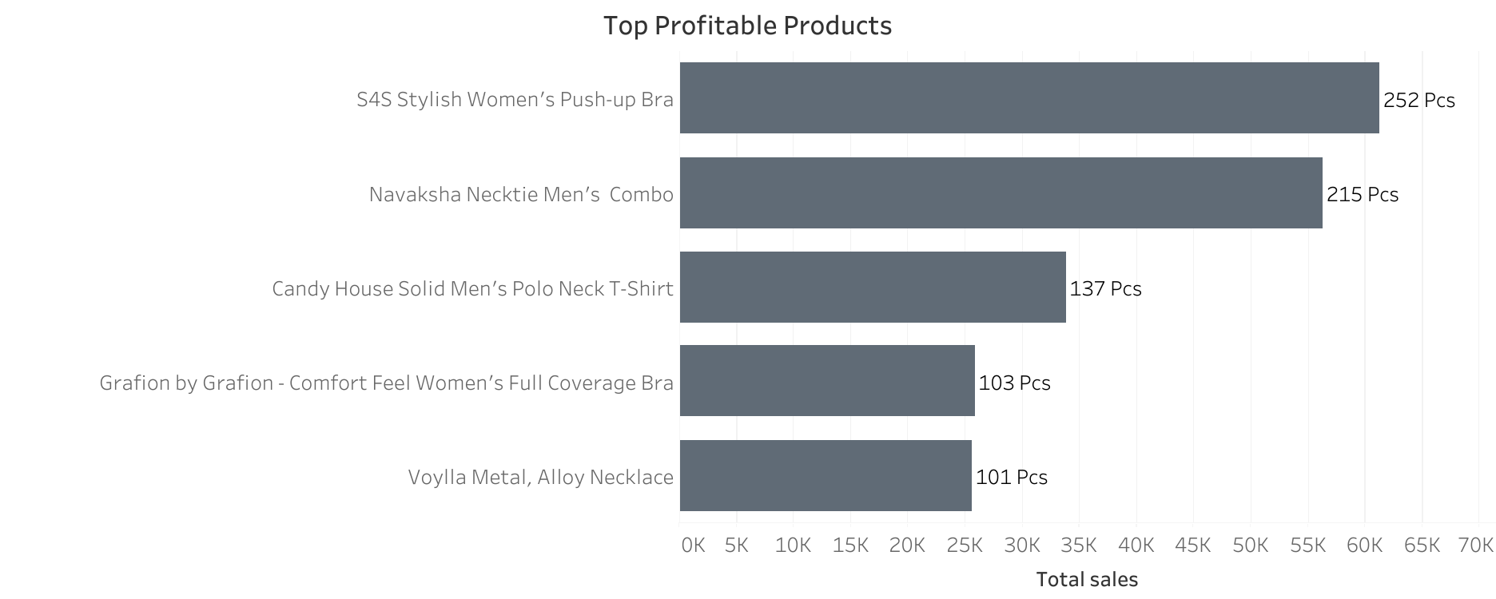
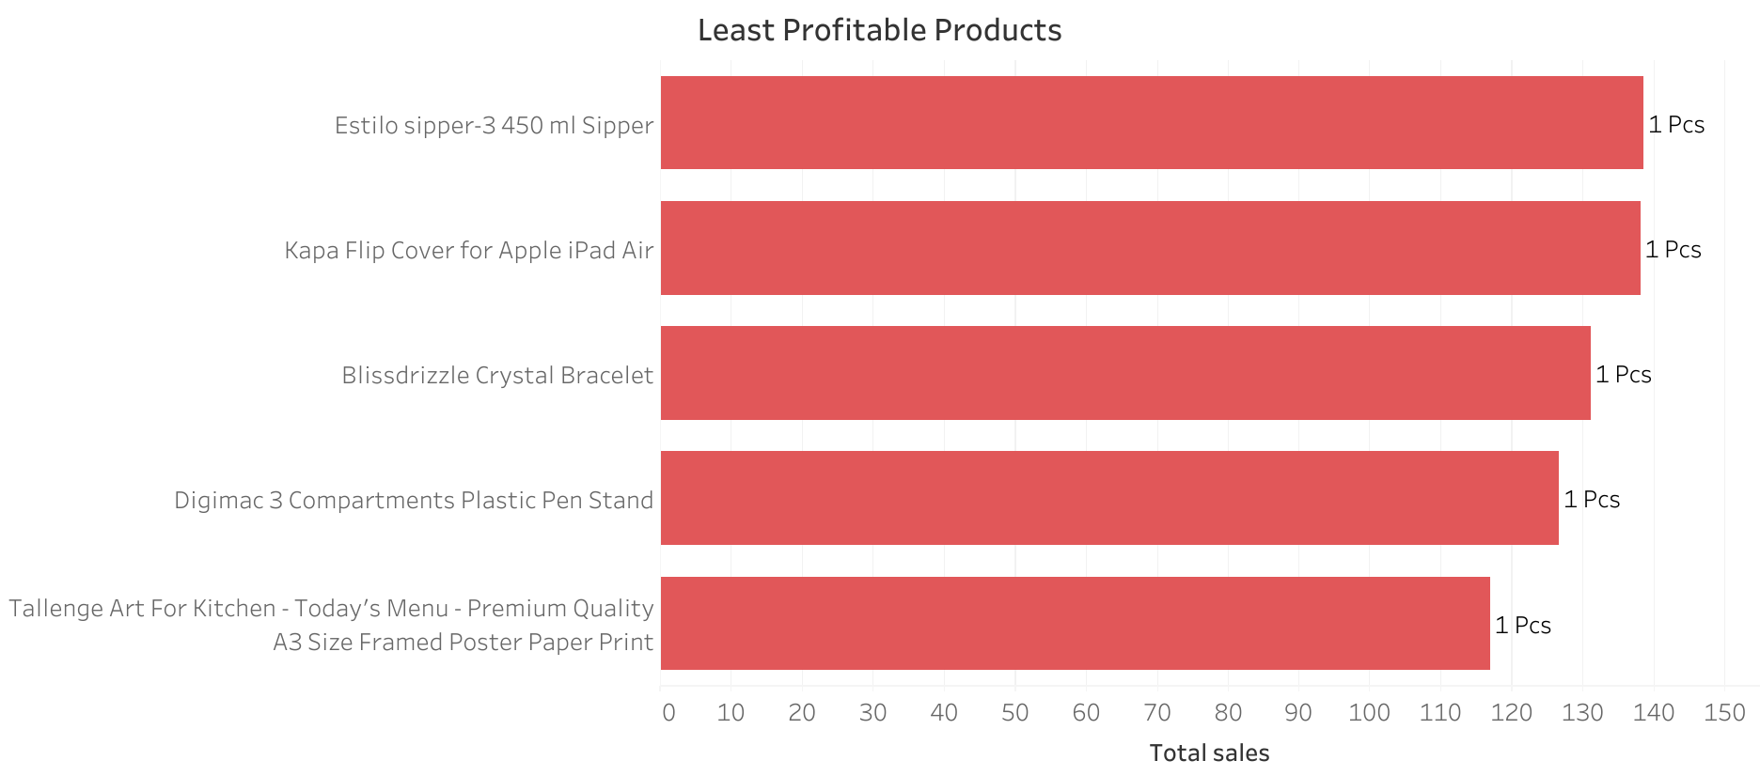
Top 5 Least and Most Profitable Products

Slide 24
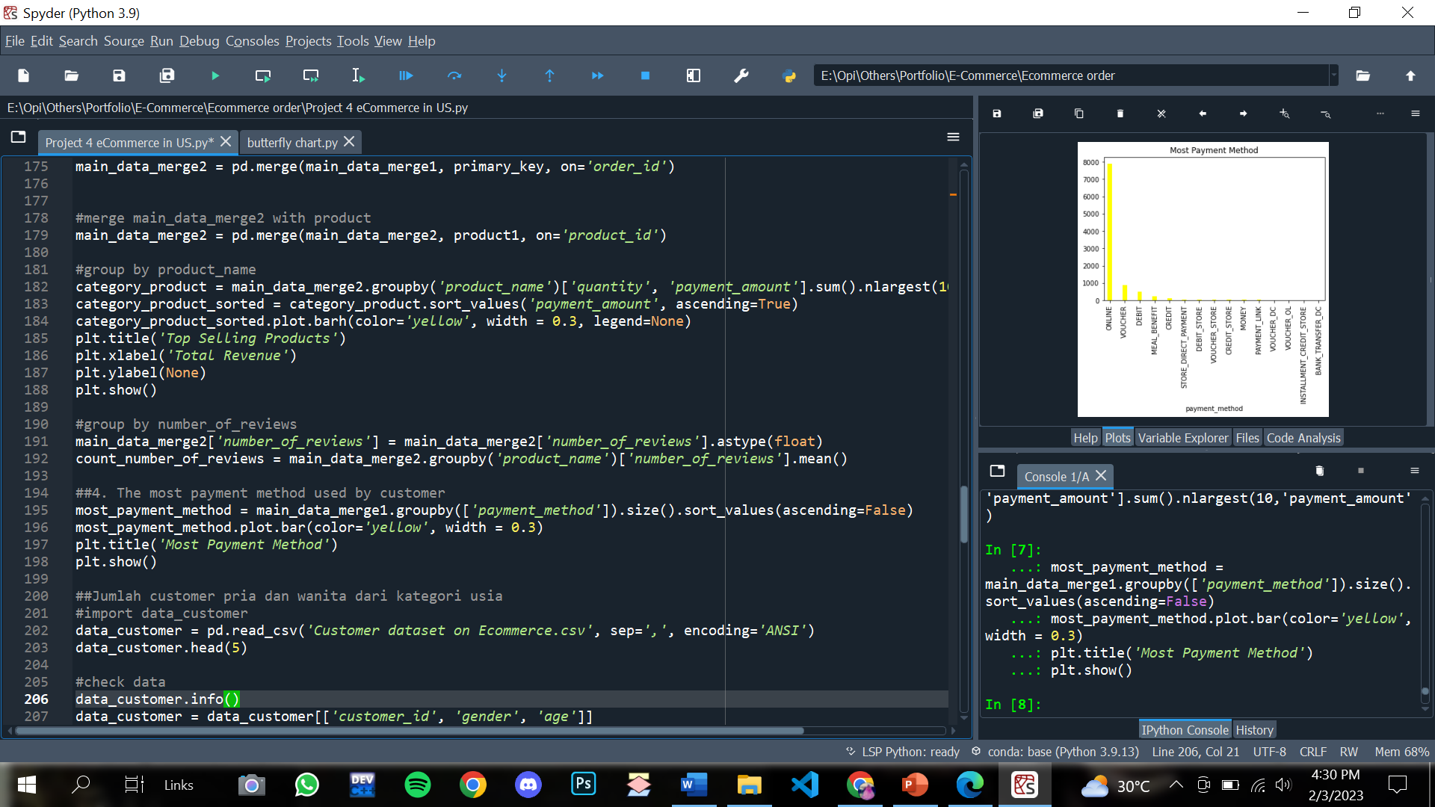
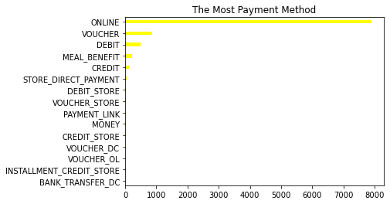
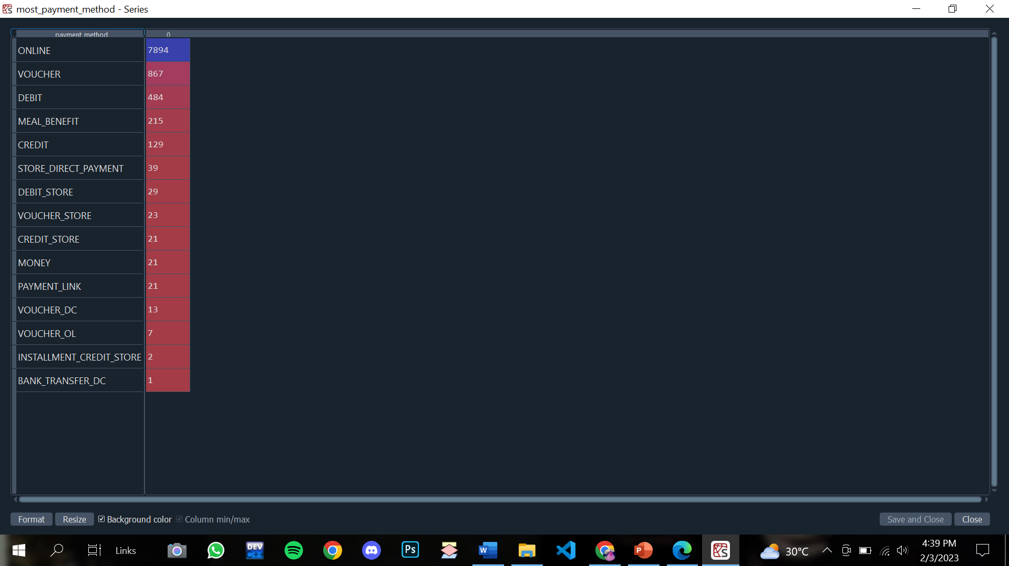
#4 The most payment method used by customer
Query:
Output:
Details Output:

Slide 25
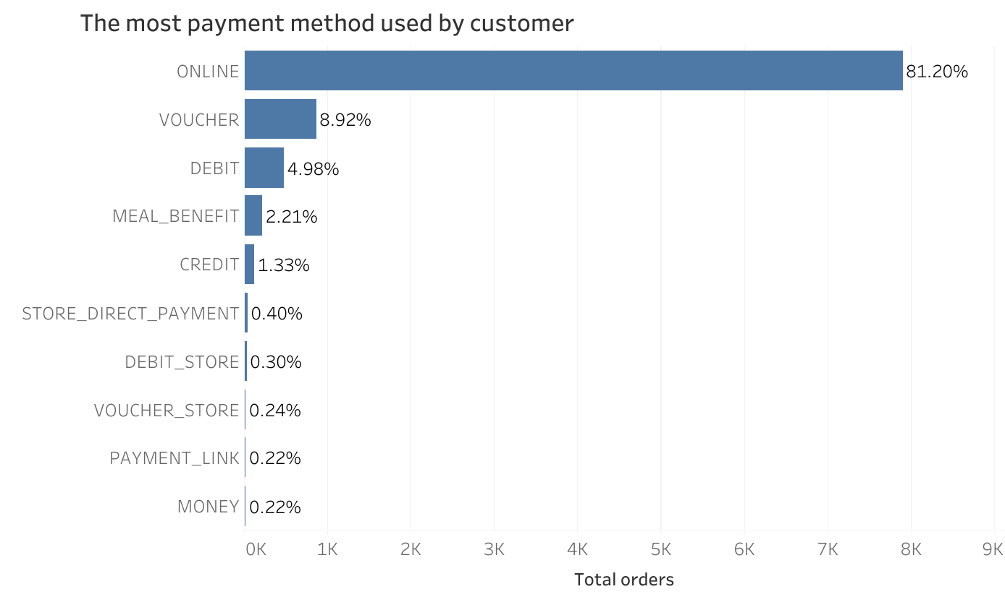
81% of Customer prefer using Online Payment Method than others
Insight:
Based on the horizontal bar chart, there are 3 most payment method used by customer. Online is the most.

Slide 26
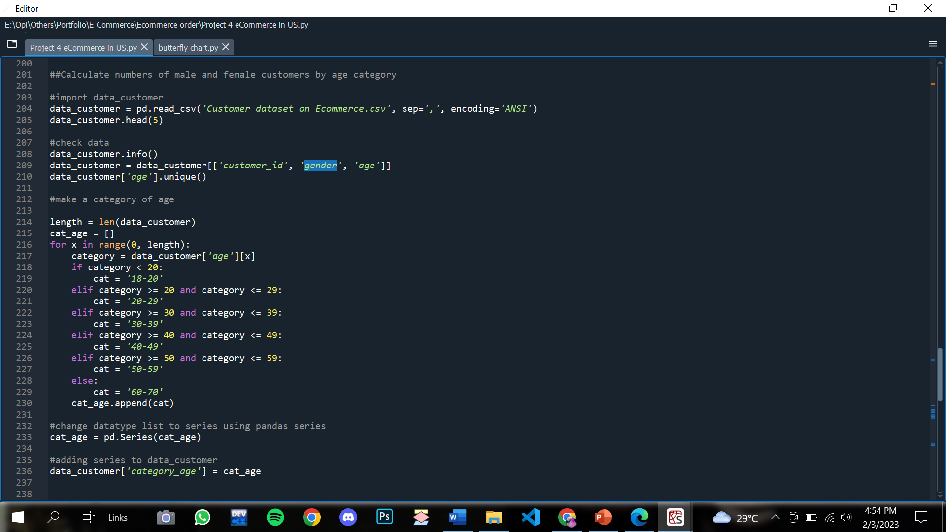
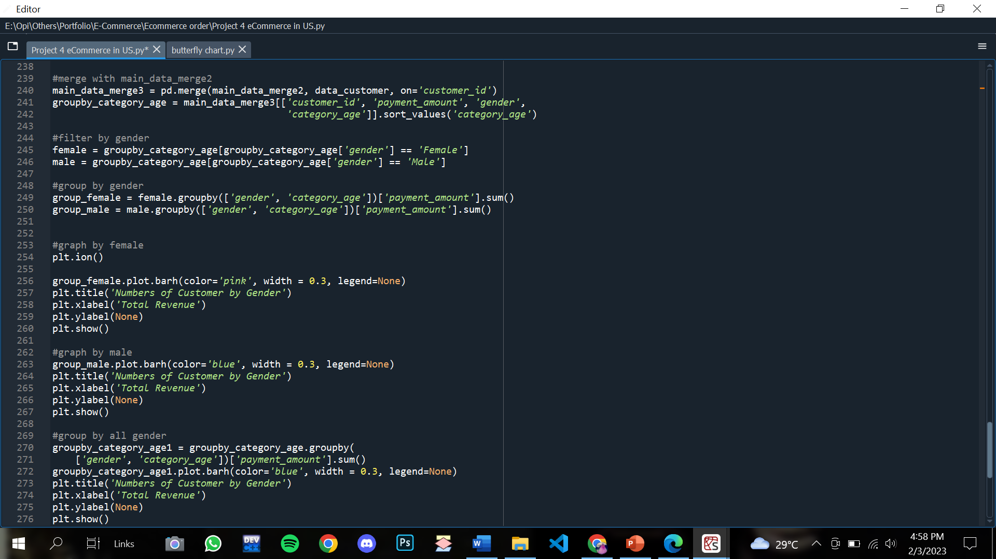
#5 Calculate numbers of male and female customers
by age category
Query:

Slide 27
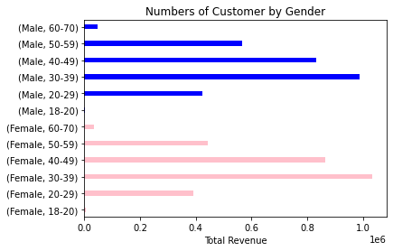
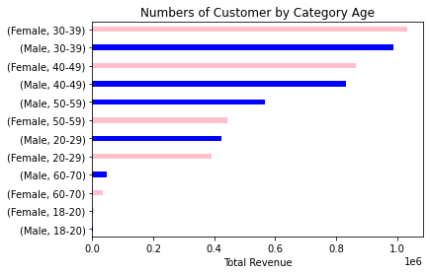
#5 Calculate numbers of male and female customers
by age category
Output:
Gender VS Category Age

Slide 28
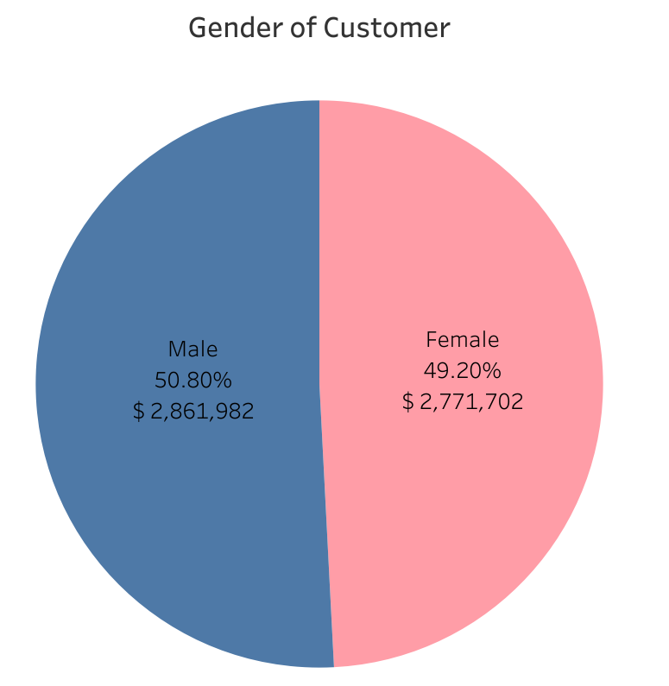
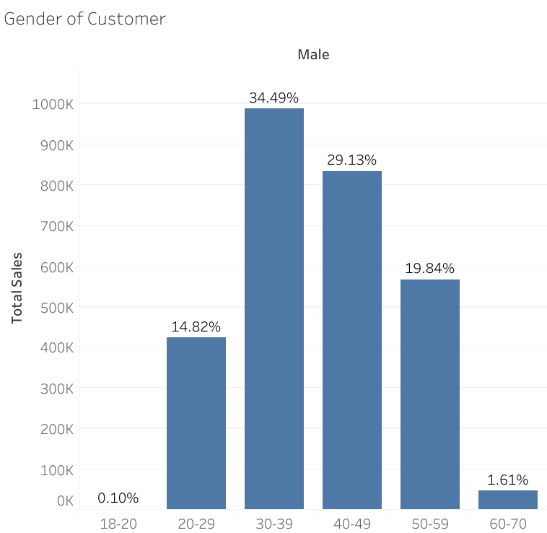
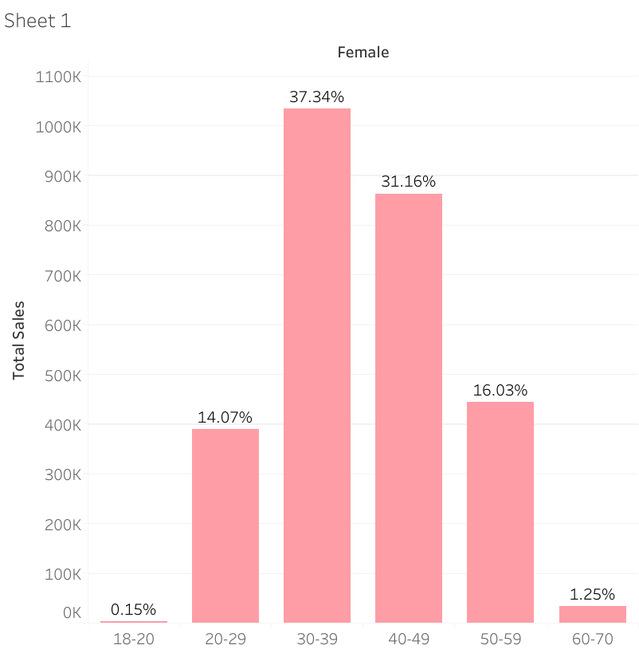
51% of Male become the most buyers in US E-Commerce
Insight:
Based on the graph above, male and female customers in the 30-39 year of age category achieve the highest percentage as the most buyers in eCommerce. When compared by gender, Male buyers account for 51% of total sales more than Female.

Slide 29
Uncover Insight & Recommendation
04

Slide 30
Summary
Based on an analysis of the development of total sales and total revenue in 2019 to 2022, it can be concluded that the eCommerce market provides significant benefits for companies. It can be seen that 2021 has been the most profitable year for the company.
There are 2 marketplaces in US E-Commerce, namely Amazon and Betsy. The competition between both marketplaces is quite tight because they only have a difference of 1% of the overall total sales. This becomes a serious consideration if the company wants to compete with other competitors.
Regarding to what products the company must provide, the company can provide the most purchased products based on the 5 top selling from the previous analysis and avoid making the same product production with the least profitable product.

Slide 31
Thanks!
Do you have any questions?
rosdianirofi@gmail.com
https://www.linkedin.com/in/rofirosdiani/
https://medium.com/@rosdianirofi
Please keep this slide for attribution

